Slide 1
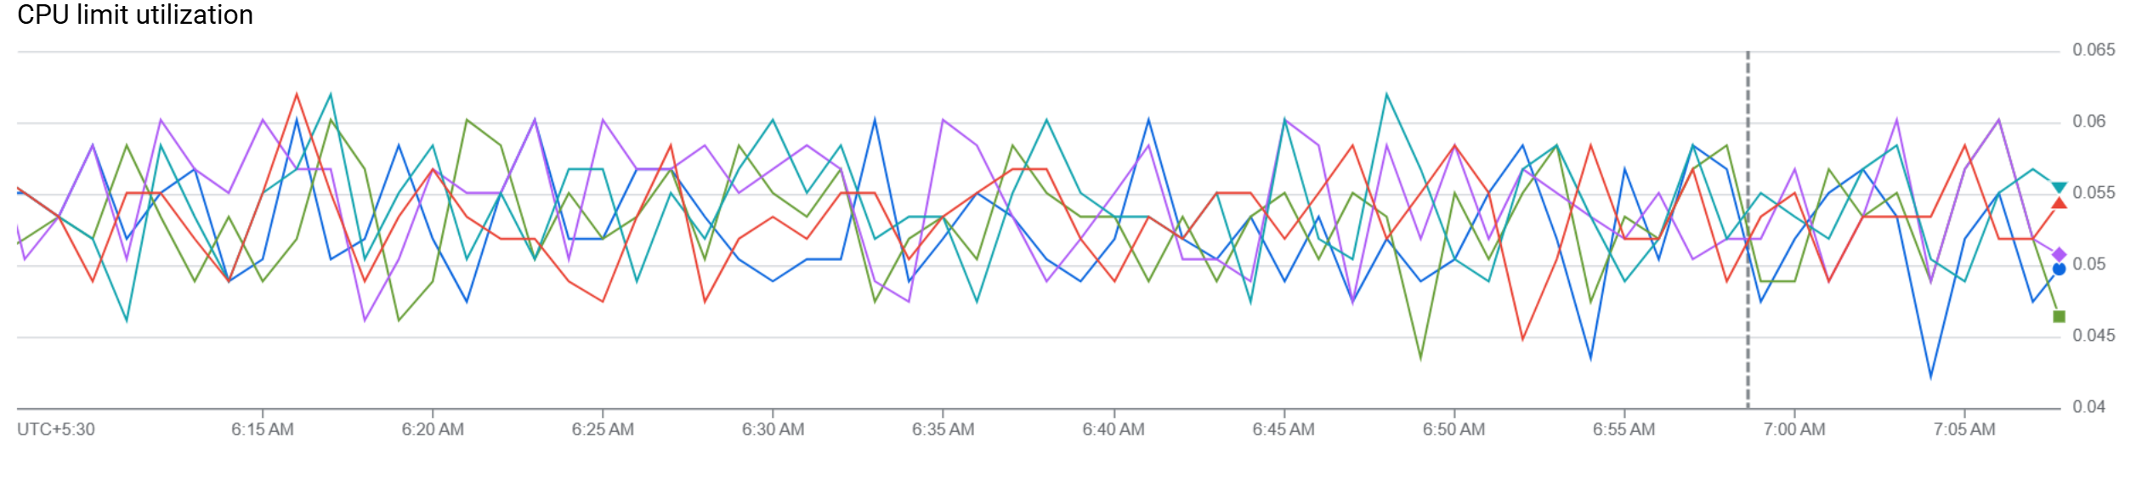
Analysis of Microservices Architecture for a SocialNetwork Platform: Deployment, Performance, andScalability on Kubernetes
Harsh Pala
Dhruvkumar Patel
Gour Krishna Dey
Pulkit Dhiman

Slide 2
PROJECT GOALS
Deploy the DeathStarBench Social Network: Containerize and orchestrate all microservices using Kubernetes.
Understand the Architecture: Analyze service interconnects, data flow, and RPC-based communi-cation.
Evaluate Performance: Measure system metrics across different configurations:
– Varying node placements
– Different IPC mechanisms
Run Load Tests: Simulate user activity and study system behavior under stress.
Optimize Deployment: Identify best deployment strategies based on experimental outcomes.

Slide 3
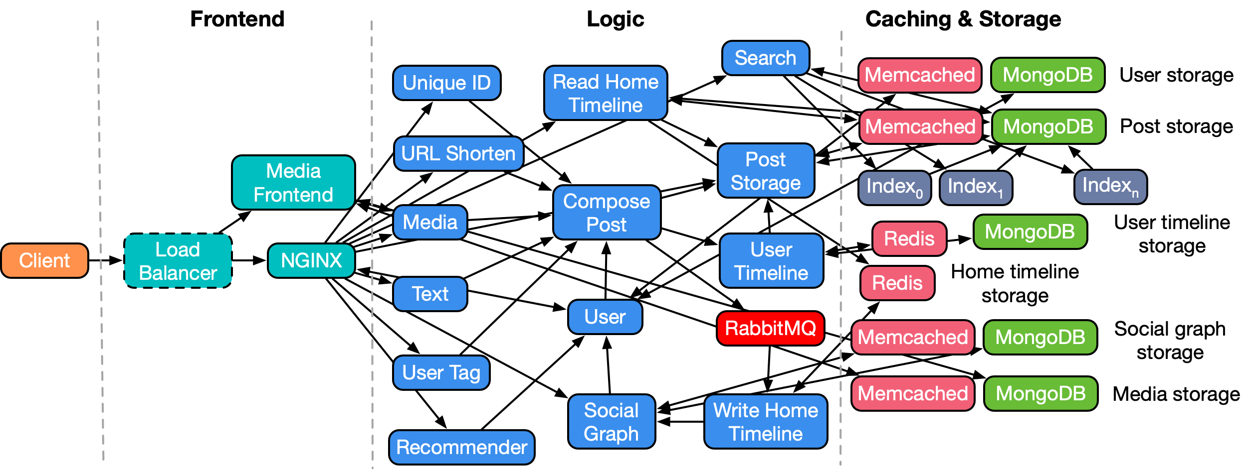
Deathstar Microservice Architecture : Social Netowrking

Slide 4
Microservices and Supporting Services
nginx-web-server: Entry point for client HTTP requests.
compose-post-service: Coordinates post creation across services.
text-service: Handles text content of posts.
media-service: Manages image/video uploads.
post-storage-service: Stores metadata about posts.
unique-id-service: Generates unique post/user IDs.
user-service: Manages user data and login info.
social-graph-service: Tracks follow relationships.
home-timeline-service: Displays posts from followed users.
user-timeline-service: Displays personal post history.
user-mention-service: Processes tagged mentions in posts.
url-shorten-service: Provides URL shortening.

Slide 5
SYSTEM IMPLEMENTATION
1. Local Deployment using Docker
2. Local Kubernetes Migration
3. Deployment on Google Cloud using Kubernetes

Slide 6

Creativity and Problem Solving
Integrating Pixie for Observability Without Prometheus Metrics
Reviving Jaeger Tracing for DeathStarBench
Other Problems:
DeathStarBench services do not expose Prometheus-compatible /metrics endpoints, making it difficult to use standard monitoring tools.
Emphasizes concerns about secure storage and ethical use of personal health data; mentions potential of encryption/blockchain
Version Compatibility
Port Conflicts
Load Testing in Kubernetes
Kubectl CLI Limitations
Service Failures and Debugging
Data Persistence

Slide 7
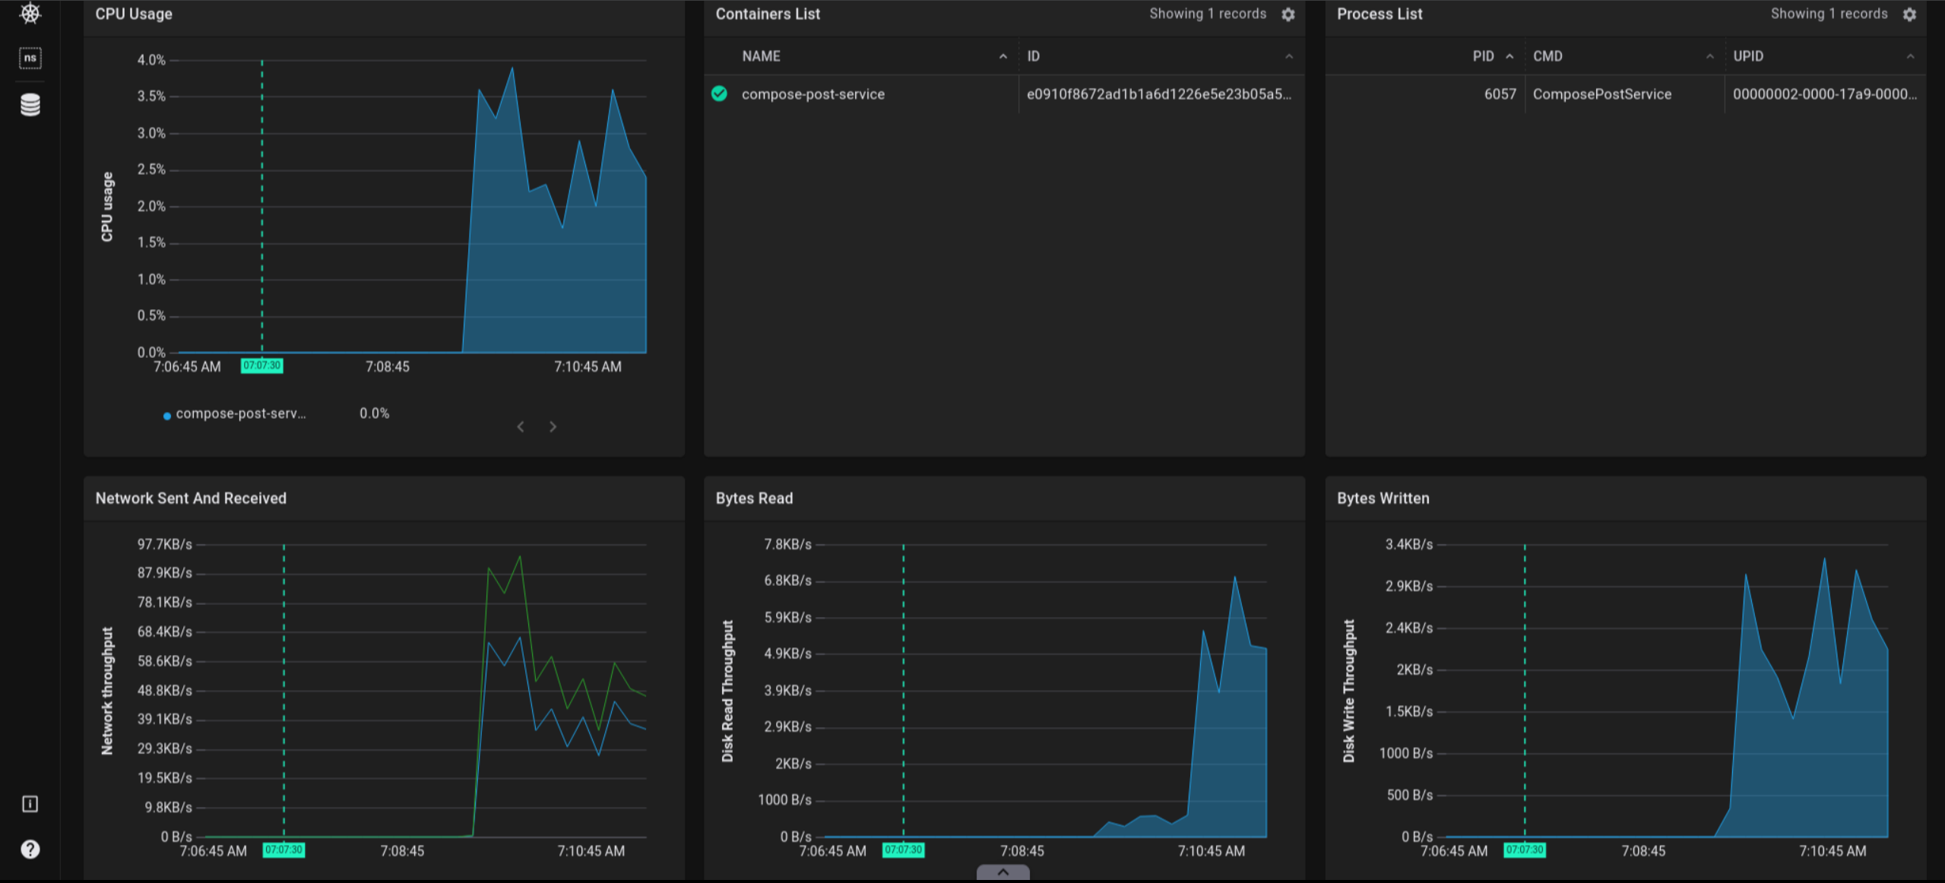
Pixie

Slide 8
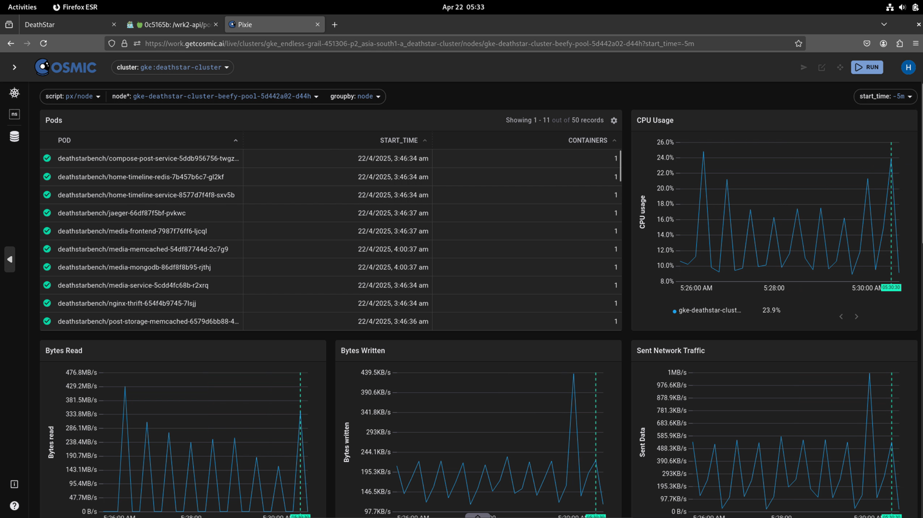
Pixie

Slide 9
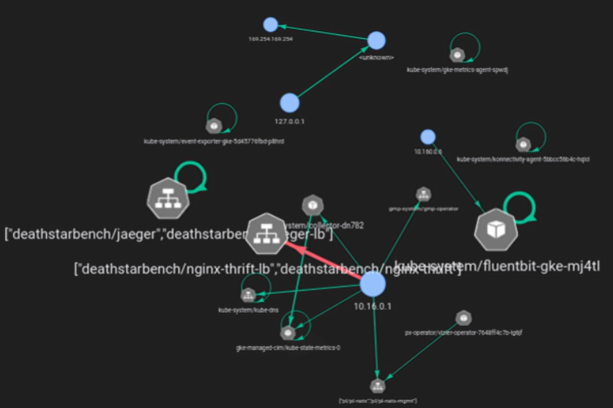
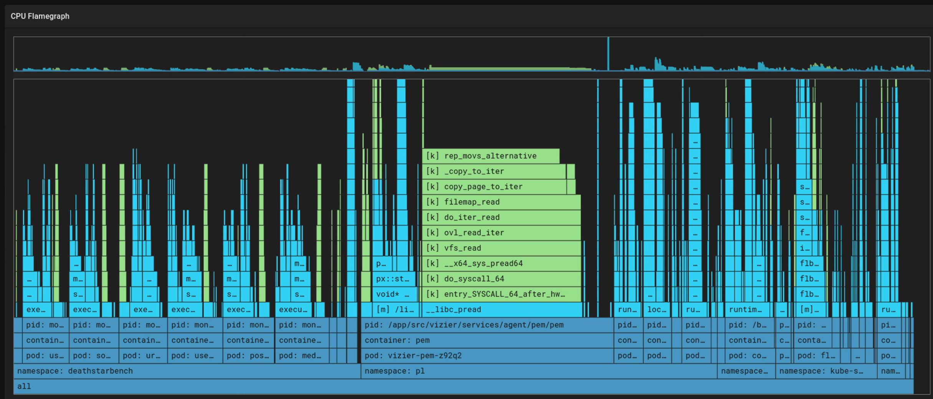
Pixie

Slide 10
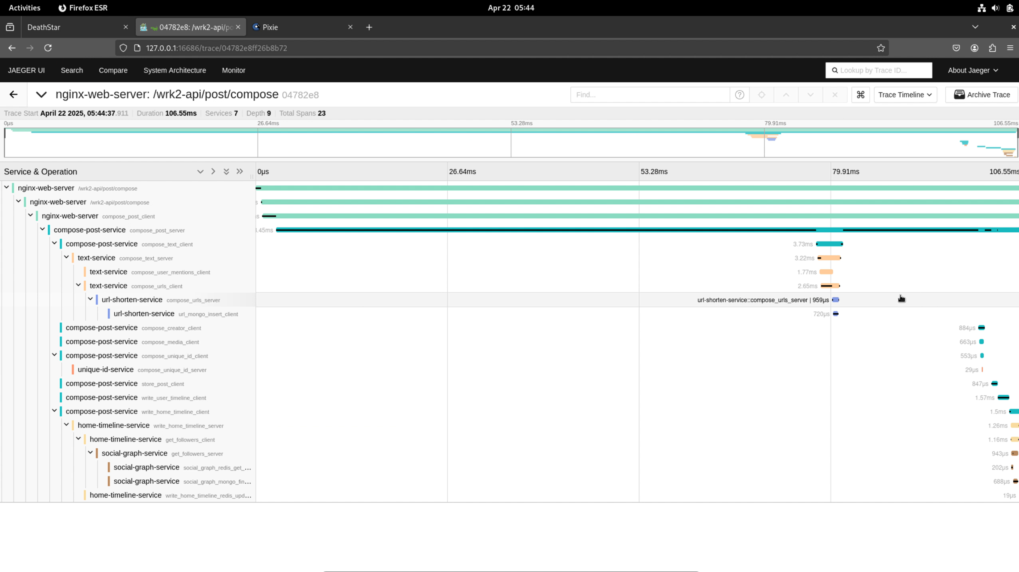
jaeger

Slide 11
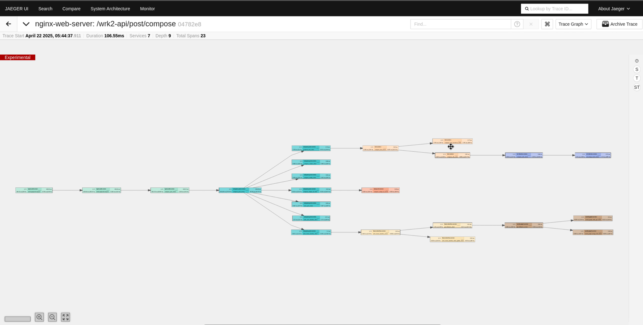
jaeger

Slide 12
SYSTEM EVALUATION
Single Node, Single Replica
The load testing was conducted using a synthetic traffic generator configured to send 10 requests per second for a duration of 60 seconds. The test was executed using 12 threads and 400 connections to mimic concurrent access patterns.
Single Node, Three Replicas - Horizontal Scaling
The synthetic load generator was configured to send 50 requests per second for 60 seconds, utilizing12 threads and 400 connections to simulate high concurrency and increased demand.

Slide 13
SYSTEM EVALUATION
Three Nodes, Single Replica Each
To test this configuration, we employed a longer-duration load test with a single thread and 8000connections for a total of 300 seconds, simulating a distributed and high-volume traffic scenario.

Slide 14
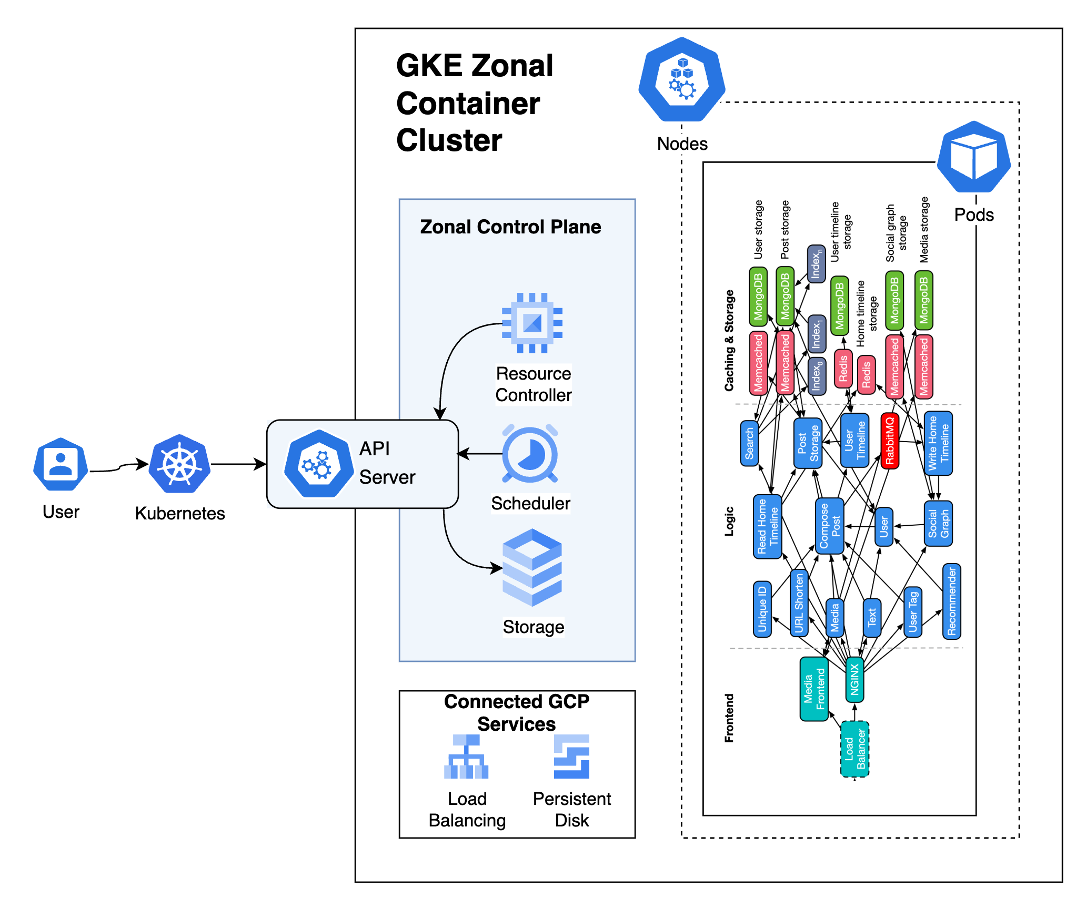
Single Node,
Single Replica

Slide 15
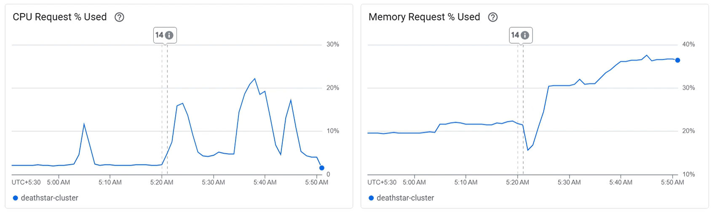
SYSTEM EVALUATION

Slide 16
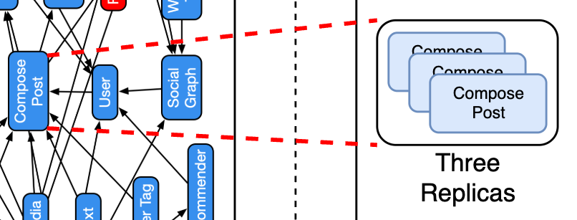
Single Node,
Three Replica

Slide 17
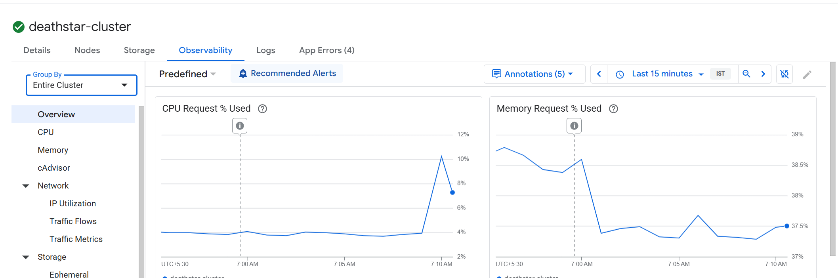
SYSTEM EVALUATION

Slide 18
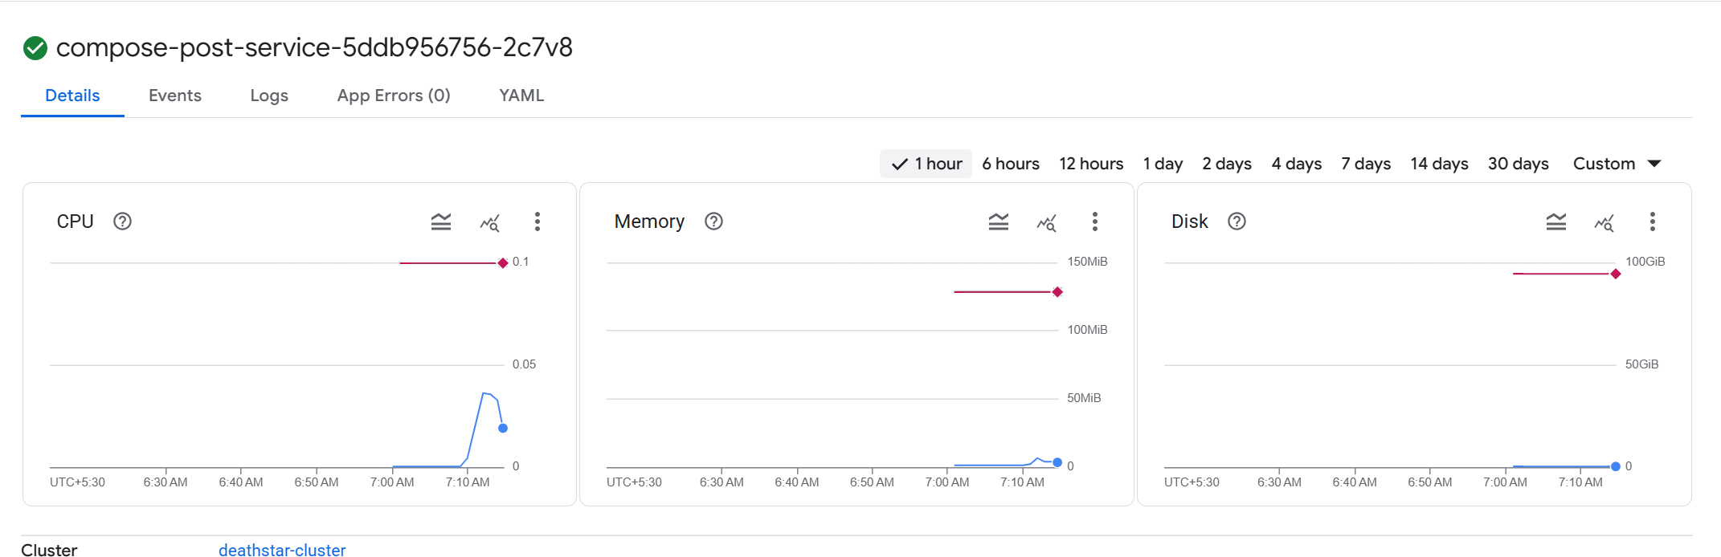
SYSTEM EVALUATION

Slide 19
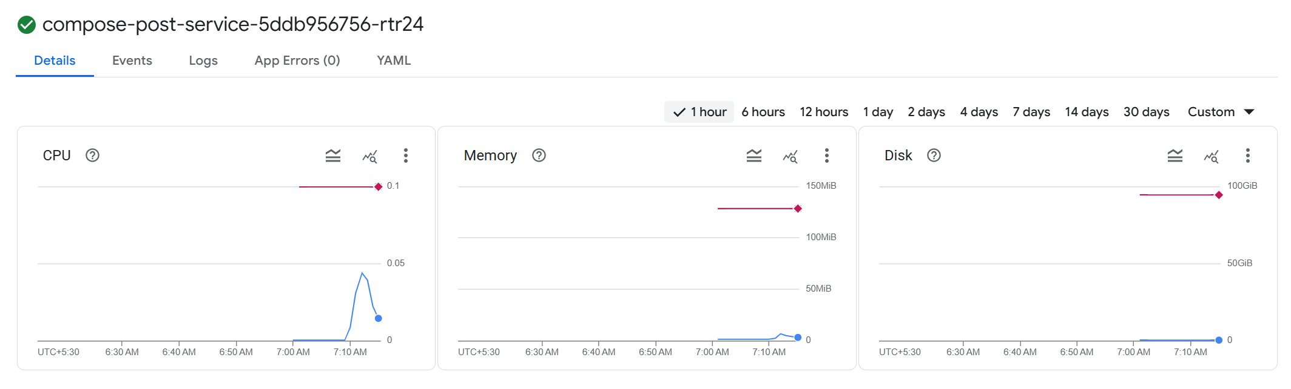
SYSTEM EVALUATION

Slide 20
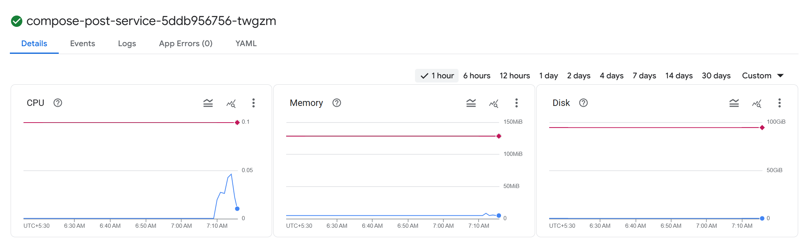
SYSTEM EVALUATION

Slide 21
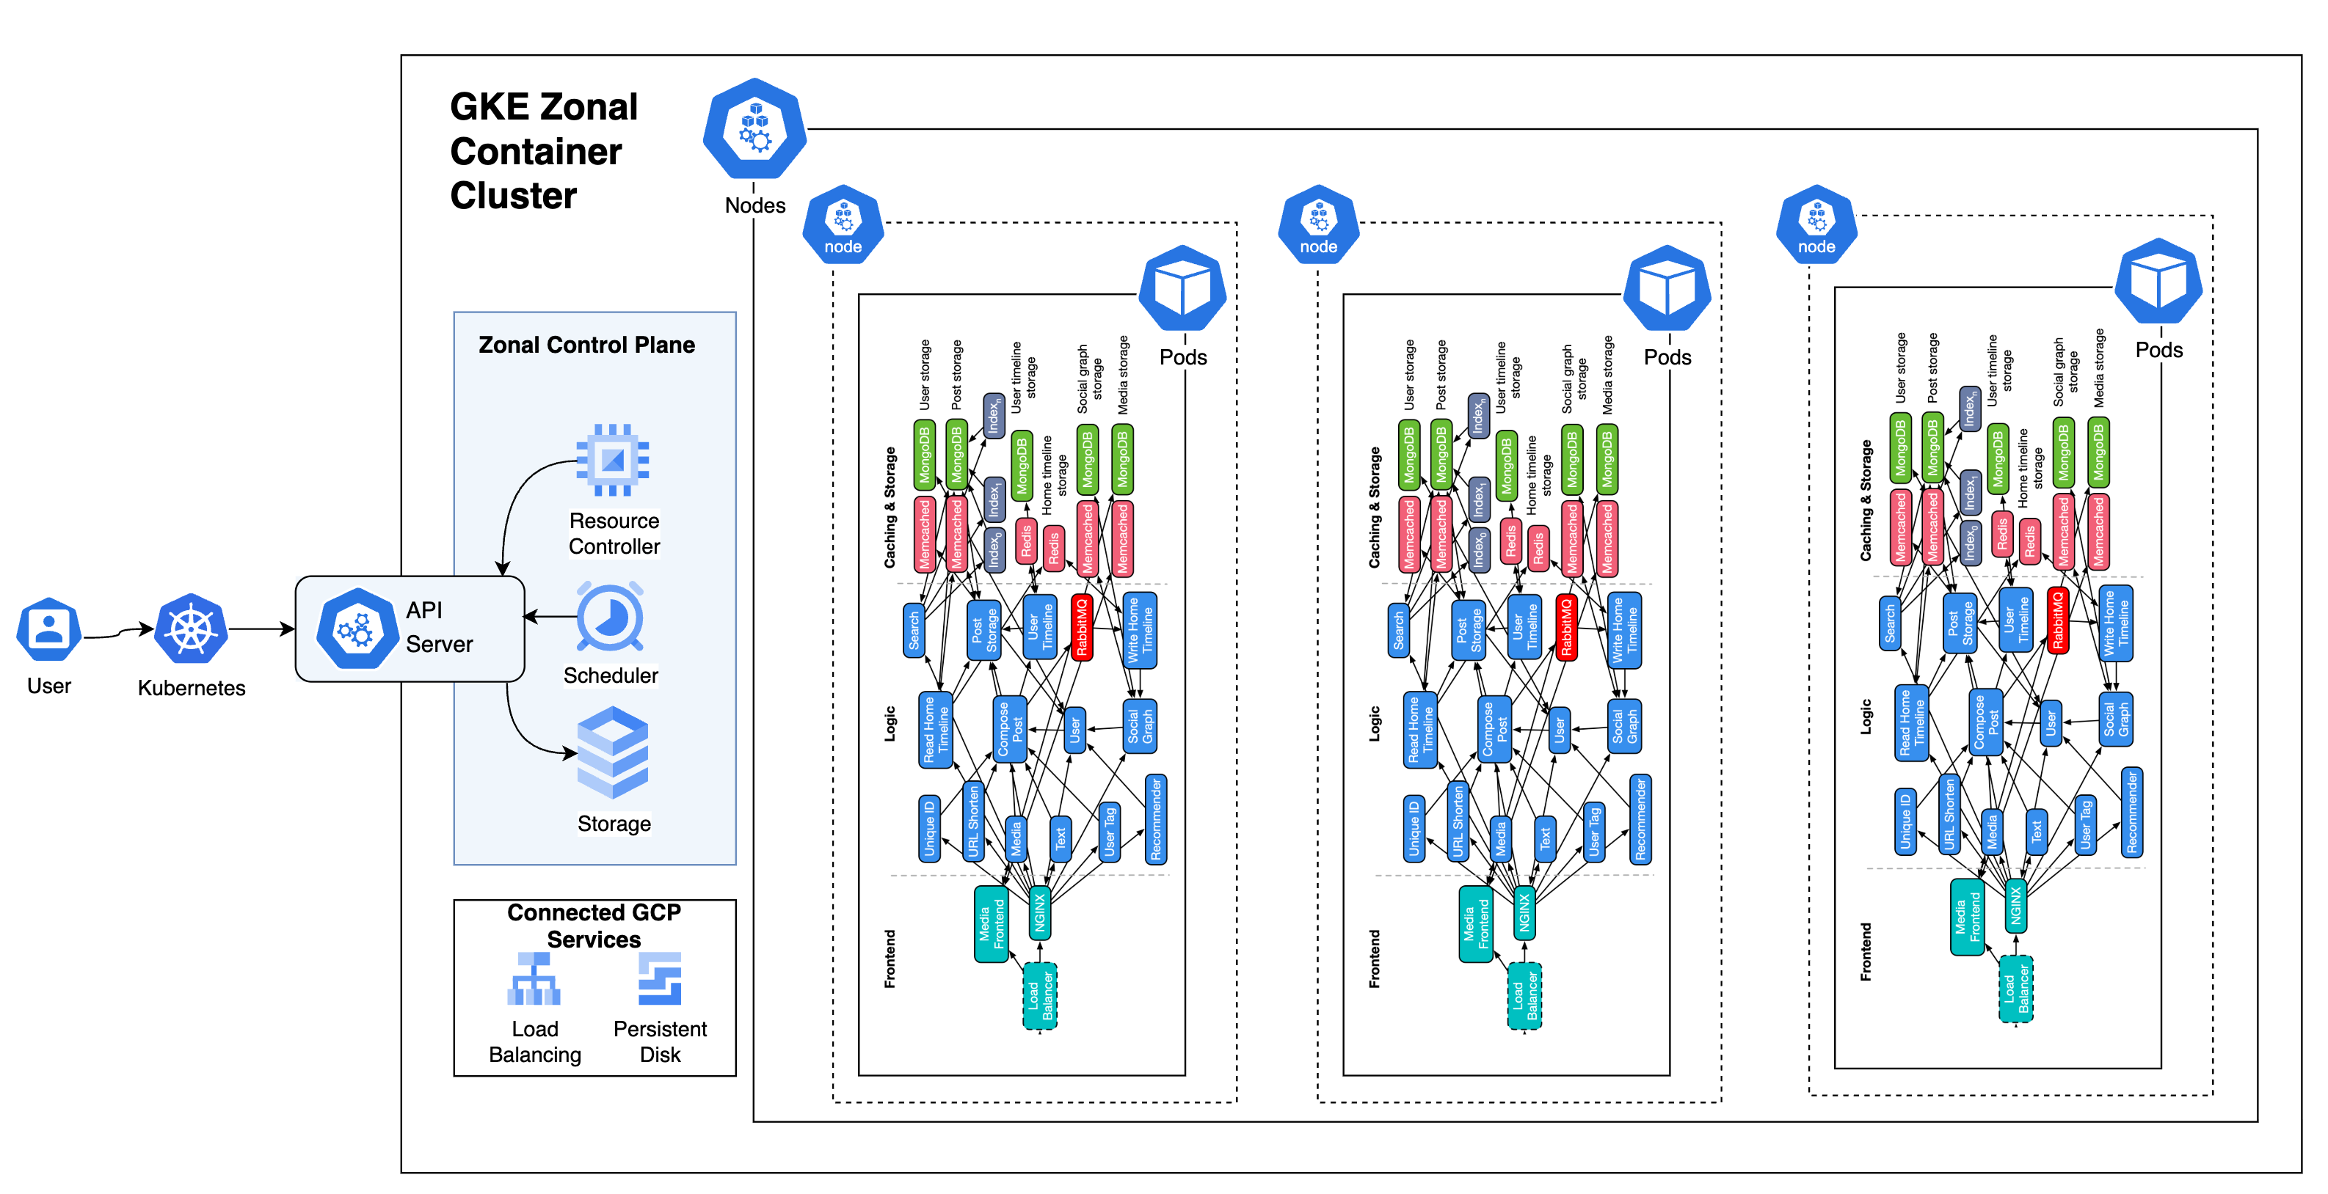
Three Nodes,
Single Replica Each

Slide 22
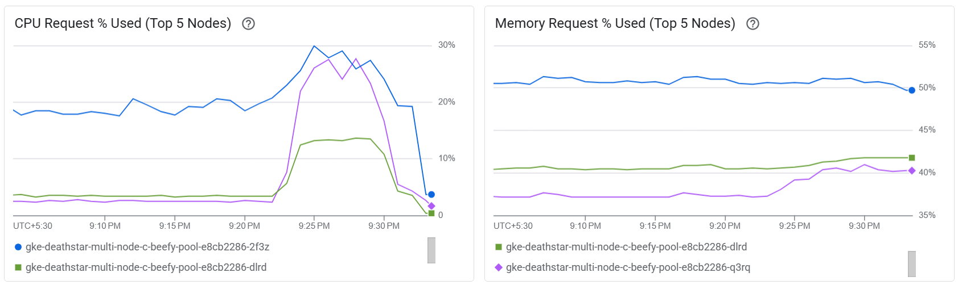
SYSTEM EVALUATION

Slide 23
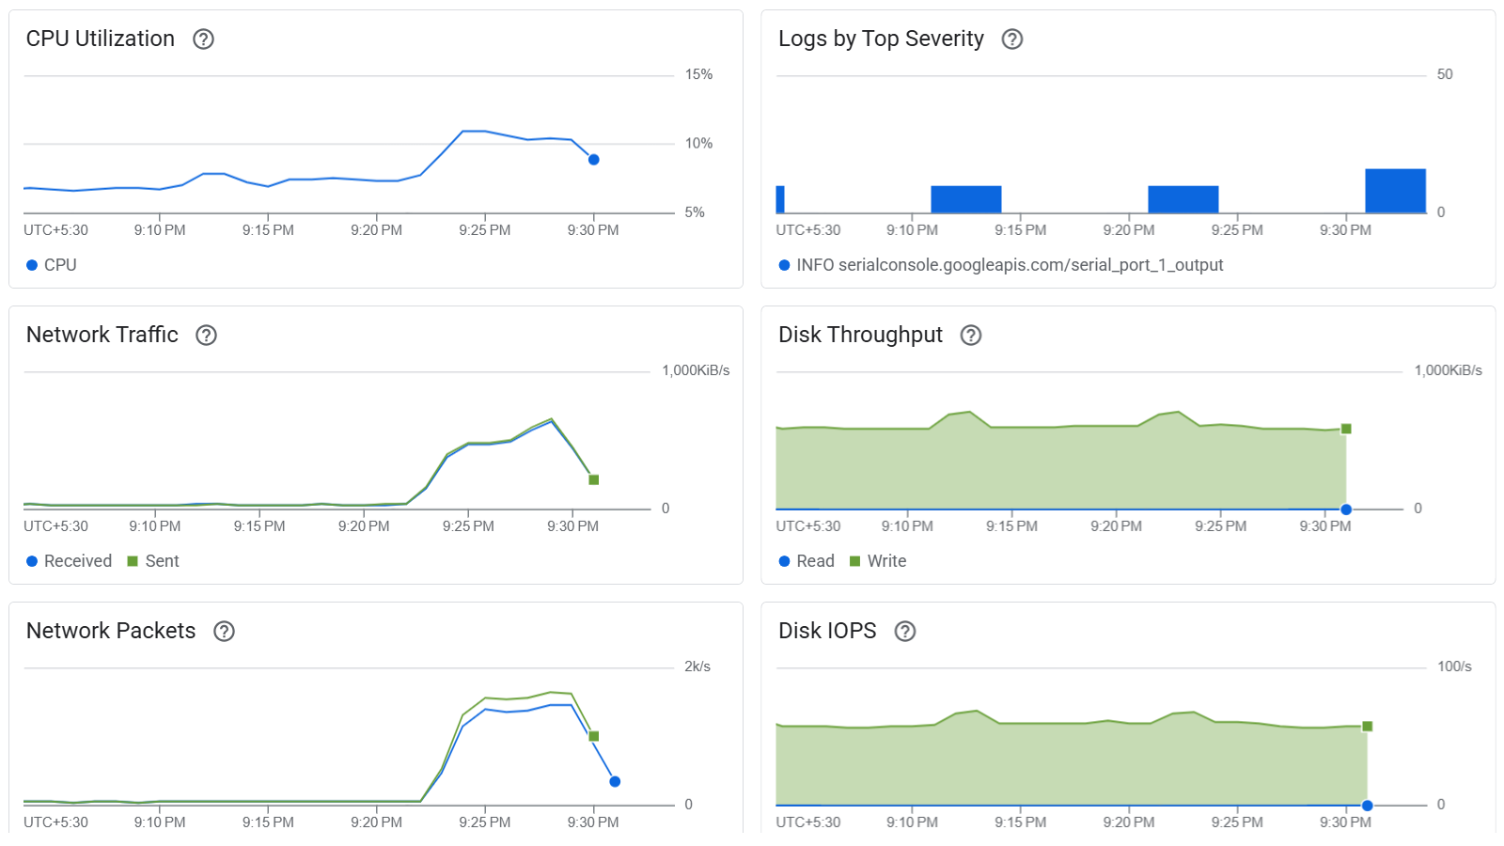
SYSTEM EVALUATION

Slide 24
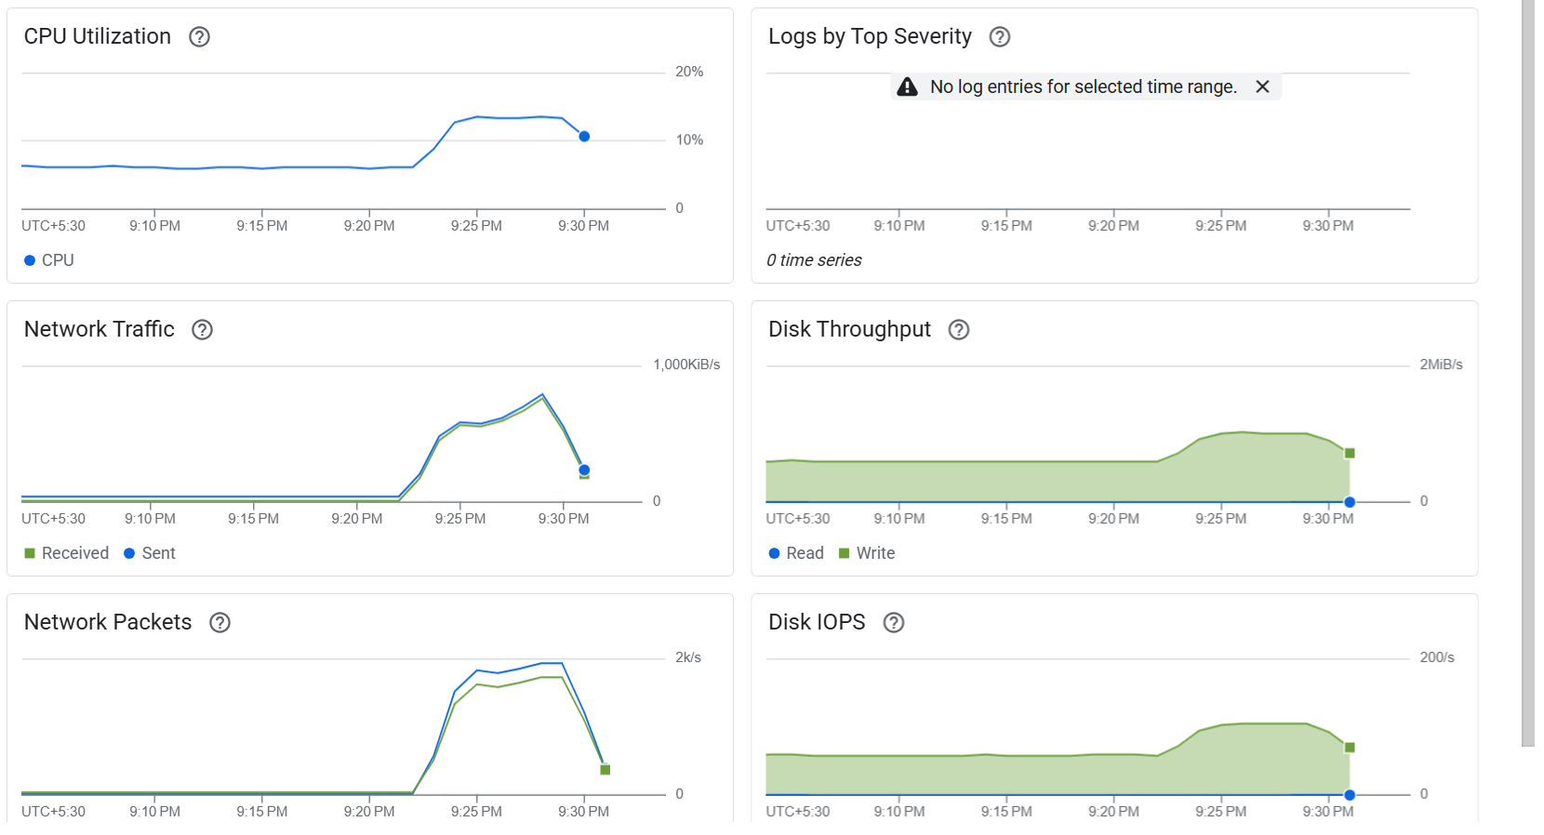
SYSTEM EVALUATION

Slide 25
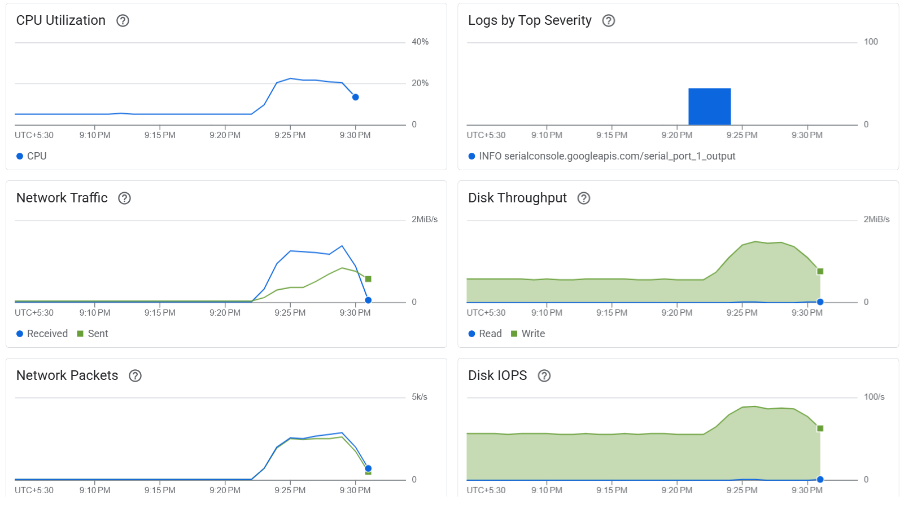
SYSTEM EVALUATION

Slide 26
Conclusion
Through this project, the DeathStarBench Social Network microservice architecture was successfully deployed, tested, and observed under both Docker and Kubernetes environments. The migration to Kubernetes enabled a more realistic infrastructure setup, mimicking production-like scalability and observability patterns.
To address the lack of native monitoring and tracing support in the benchmark:
Pixie was integrated into the local Kubernetes deployment to enable real-time observability without code instrumentation.
Jaeger was revived with manual header propagation and custom tracing patches, enabling end-to-end distributed tracing.

Slide 27
Conclusion
Observability was extended to Google Cloud, where the same services were deployed and monitored using:
– Cloud Monitoring for system metrics.
– Cloud Logging for logs aggregation.
– Cloud Trace and Profiler for latency analysis and CPU profiling.

Slide 28
Conclusion
Performance Testing & CPU Utilization Patterns
CPU utilization: Pixie plots, GCP.
Memory allocation: Pixie dashboards, GCP.
Network traffic: Pixie NetFlow view, GCP.
Pod-level performance: Kubernetes Metrics + GCP.
Inter-service latency: Pixie + Jaeger Traces.

Slide 29
Conclusion
These insights revealed clear utilization patterns:
Services like compose-post, user, and media saw high CPU spikes under heavy concurrency.
Backend services maintained more consistent resource usage but exposed bottlenecks in I/O.
Network throughput and response times correlated directly with service chaining and load bursts.
Cloud observability helped validate these behaviors at scale, revealing differences in auto-scaling efficiency and network overheads.

Slide 30
Conclusion
Overall, the combination of local and cloud-based observability, custom engineering fixes, and varied performance tests enabled a deep understanding of system behavior — supporting improved scaling strategies, fault diagnosis, and deployment optimizations.

Slide 31
REFERENCES
Y. Gan, Y. Zhang, D. Cheng, A. Shetty, P. Rathi, N. Katarki, A. Bruno, J. Hu, B. Ritchken, B. Jackson, K. Hu, M. Pancholi,Y. He, B. Clancy, C. Colen, F. Wen, C. Leung, S. Wang, L. Zaruvinsky, M. Espinosa, R. Lin, Z. Liu, J. Padilla, andC. Delimitrou, “An open-source benchmark suite for microservices and their hardware-software implications for cloud edgesystems.” in ASPLOS, I. Bahar, M. Herlihy, E. Witchel, and A. R. Lebeck, Eds. ACM, 2019, pp. 3–18. [Online]. Available: http://dblp.uni-trier.de/db/conf/asplos/asplos2019.htmlGanZCSRKBHRJHPH19

Slide 32
Thank You

